Slide 1
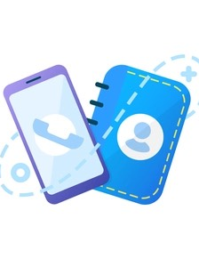
PHONE BOOK MANAGEMENT
GIRITHAR V (RA2111013010003)
VAMSI S(RA2111013010032)

Slide 2
INTODUCTION
Phone Book system is a small web application developed for project. In older days we stored all our important contact details in books and papers. Here we proposed a new system using this application we can store all the details in central repository. In manual method if we forget information book then it very difficult to get the contact details.
By using this application, we can see our contacts anywhere in the world, here we will have security to the login page and no one can see our contacts with out proper authentication. In this project we can save our contacts, address and we can search them by name and also, we can see all them at a time.

Slide 3
ABOUT THE PROJECT
The Phone Book project is developing a program which deals with the combination of structures, arrays, File pointers and other functions. This program could do some operations on arrays such as insertion, deletion, sorting, searching, update, retrieve, merging, append, exit.
Personal information such as name, sex, father’s name, phone number, citizenship number, email and address are asked while adding a record into the Phonebook. These records can then be modified, listed, searched for and removed.

Slide 4
SUMMARY
The main idea of ​​the program is to increase awareness of computer systems and the use of computer resources. The main purpose of this package is to reduce the pressure on users to learn more about computers and software. This helps maintain a direct connection between the computer and the user.

Slide 5
CONCLUSION
The application software has been implemented successfully by using test cases .And the language used is C language. This application is used to search, delete, modify and some functions which is used to remember our friends details more easily.

